Slide 1
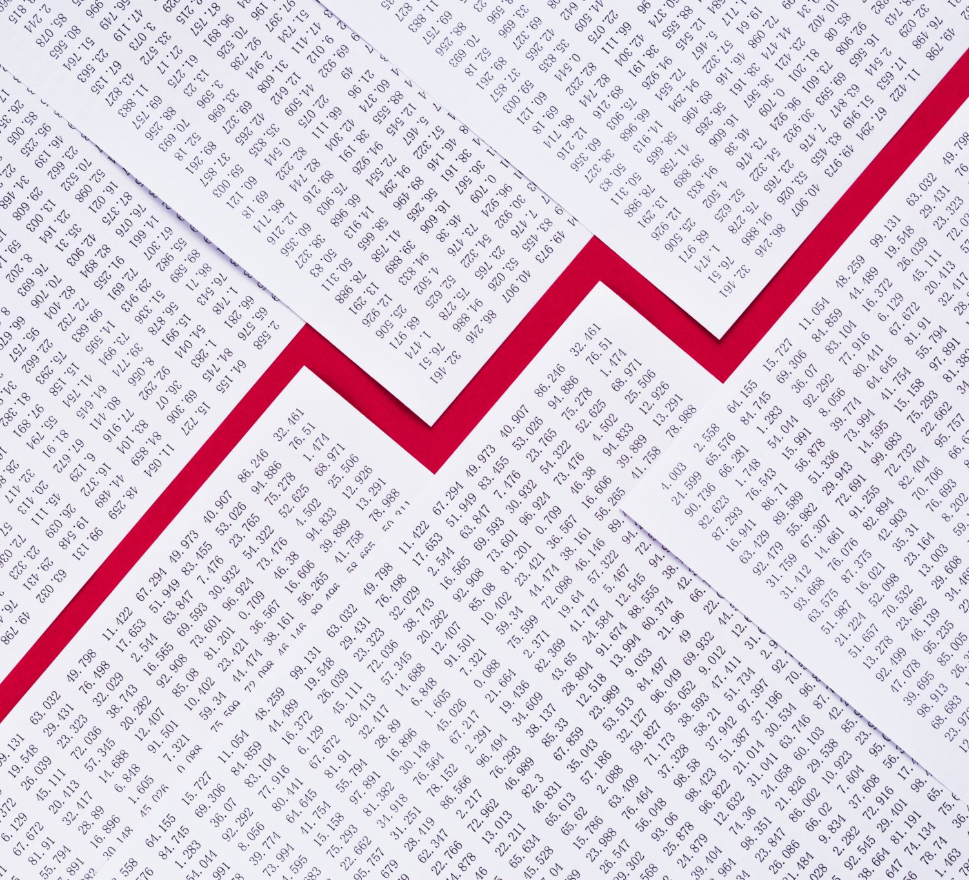
United States Economic Forecast
Oussama Ennaciri
Anderson College of Business and Computing
Regis University
Data engineering
Prof. Christy Pearson
January 26th, 2024

Slide 2
Problem statement
Is the U.S. economy heading toward a recession or growth?

Slide 3
Data description
My data consists for macroeconomic indicators that I will use to predict cycles in the United States’ economic activity. The data set is organized based on the time intervals used in reporting and categorized according to the sectors they relate to.
The data was retrieved from the Federal Reserve’s website using the tool FRED. https://fred.stlouisfed.org/seriesBeta/GDP#

Slide 4
Data description
Overall Economic Activity :
GDP : Gross Domestic Product, Billions of Dollars, Quarterly, Continuous. Reflects overall economic health.
GDPC1 : Real Gross Domestic Product, Billions of Chained 2017 Dollars, Quarterly, Continuous. Reflects overall economic health more accurately than nominal GDP.

Slide 5
Data description
Consumer Spending :
PCE : Personal Consumption Expenditures, Billions of Dollars, Monthly, Continuous. Reflects consumer confidence.

Slide 6
Data description
Housing :
HOUST : New Privately-Owned Housing Units Started: Total Units, Thousands of Units, Monthly, Discrete. Reflects the state of the housing market.

Slide 7
Data description
Business Investment
A053RC1Q027SBEA : National income: Corporate profits before tax (without IVA and CCAdj), Billions of Dollars, Quarterly, Continuous. Reflects the financial health of businesses

Slide 8
Data description
Foreign Trade :
IMPGSC1 : Real imports of goods and services, Billions of Chained 2017 Dollars, Quarterly, Continuous. Reflect the demand for foreign goods and services.
EXPGSC1 : Real Exports of Goods and Services, Billions of Chained 2017 Dollars, Quarterly, Continuous. reflect the demand for domestic goods and services.

Slide 9
Data description
Government Policy :
GCEC1 : Real Government Consumption Expenditures and Gross Investment, Billions of Chained 2017 Dollars, Quarterly, Continuous. Reflect government efforts to stimulate the economy.

Slide 10
Data description
Labor Markets :
UNRATE : Unemployment Rate, Percent, Monthly, Continuous. Reflects the state of the Labor Market.

Slide 11
Data description
Financial Markets
FEDFUNDS : Federal Funds Effective Rate, Percent, Monthly , Continuous. Reflect the Federal Reserve’s efforts to stimulate the economy.
GS10 : Market Yield on U.S. Treasury Securities at 10-Year Constant Maturity, Quoted on an Investment Basis, Percent, Monthly, Continuous. Reflects confidence.

Slide 12
Data description
Prices :
CPIAUCSL : Consumer Price Index for All Urban Consumers: All Items in U.S. City Data Updated: 2025-01-15 Average, Index 1982-1984=100, Monthly, Continuous.

Slide 13
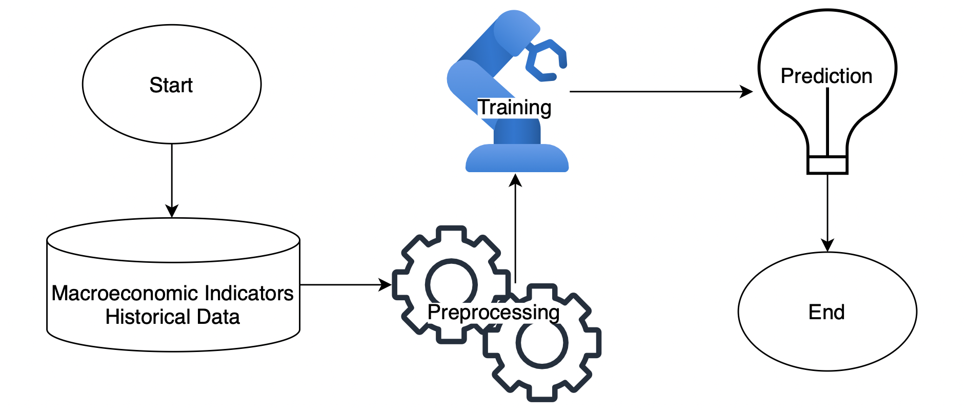
MLS

Slide 14
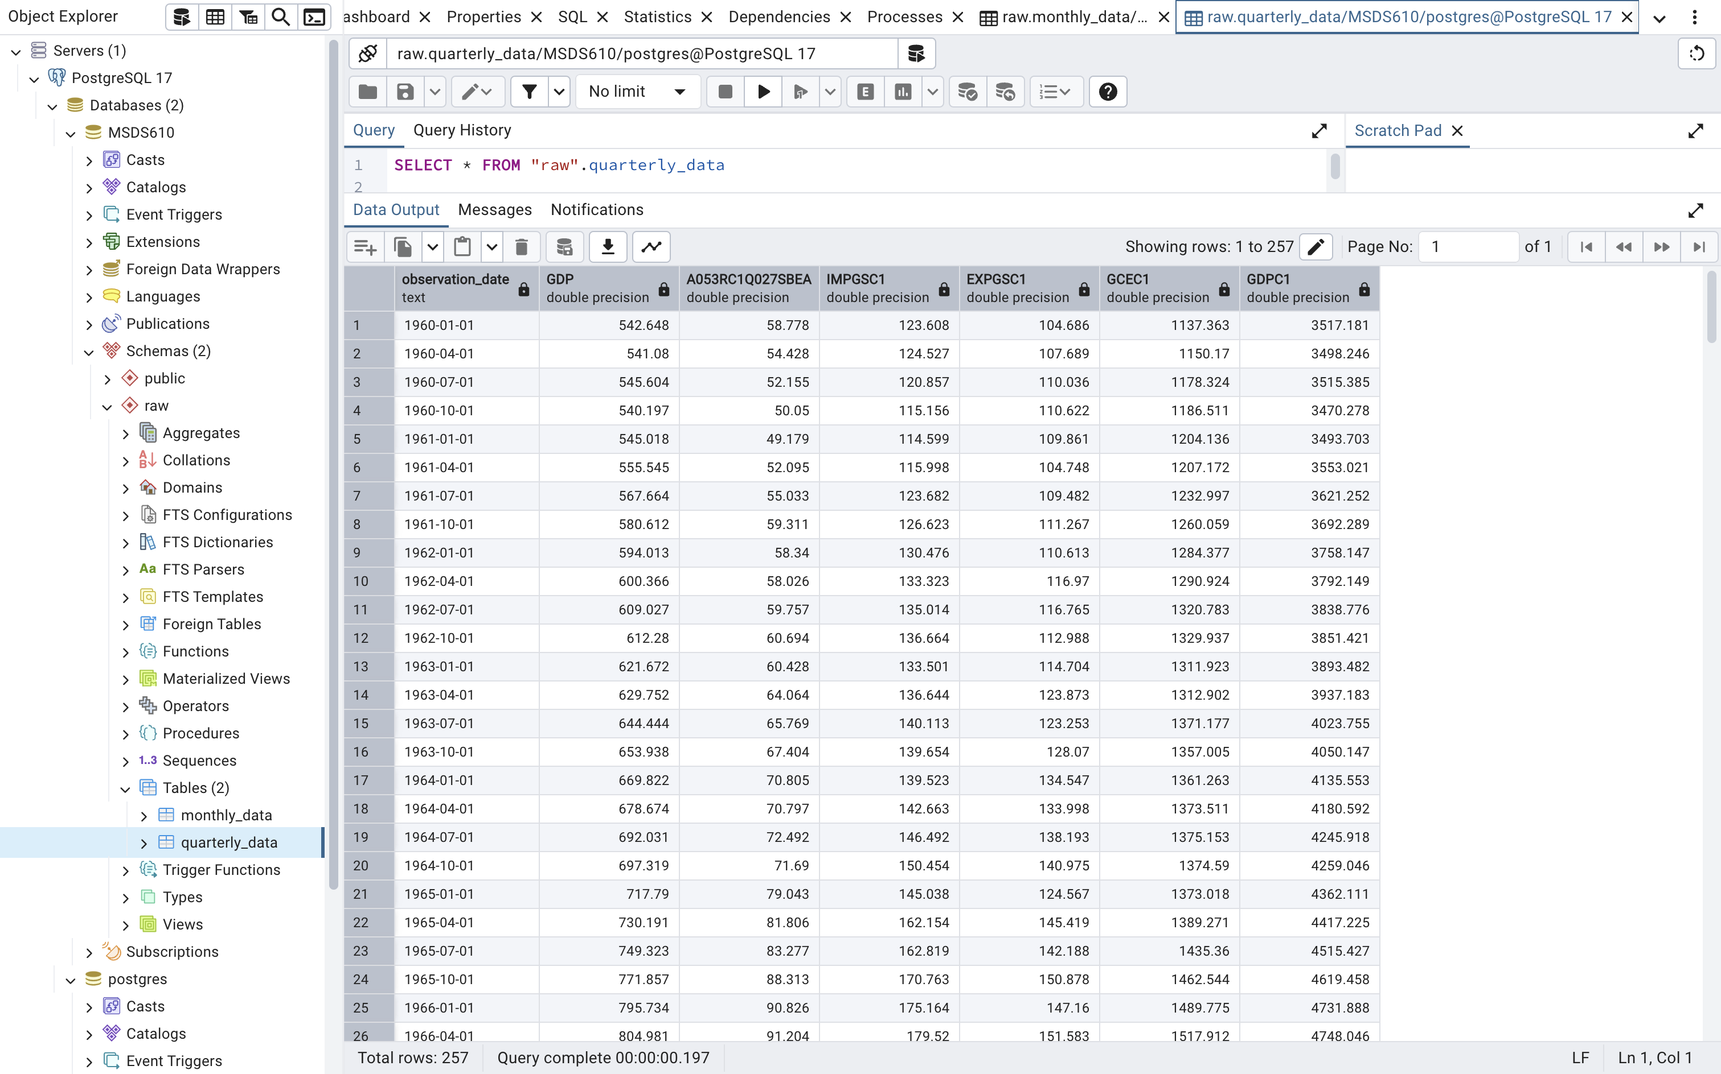
Loaded quarterly data

Slide 15
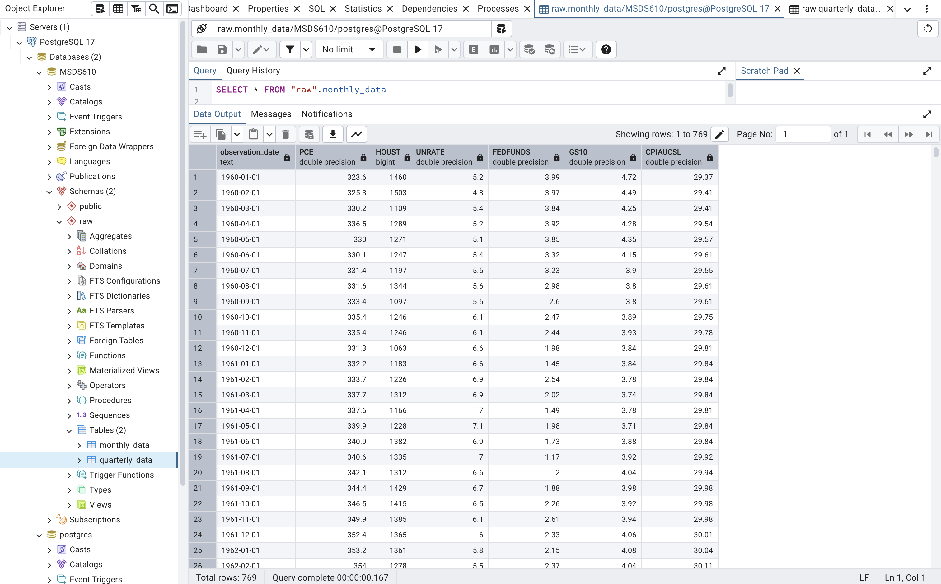
Loaded monthly data

